Slide 1
HARDWARE TEXTURES
DEV4 day6

Slide 2
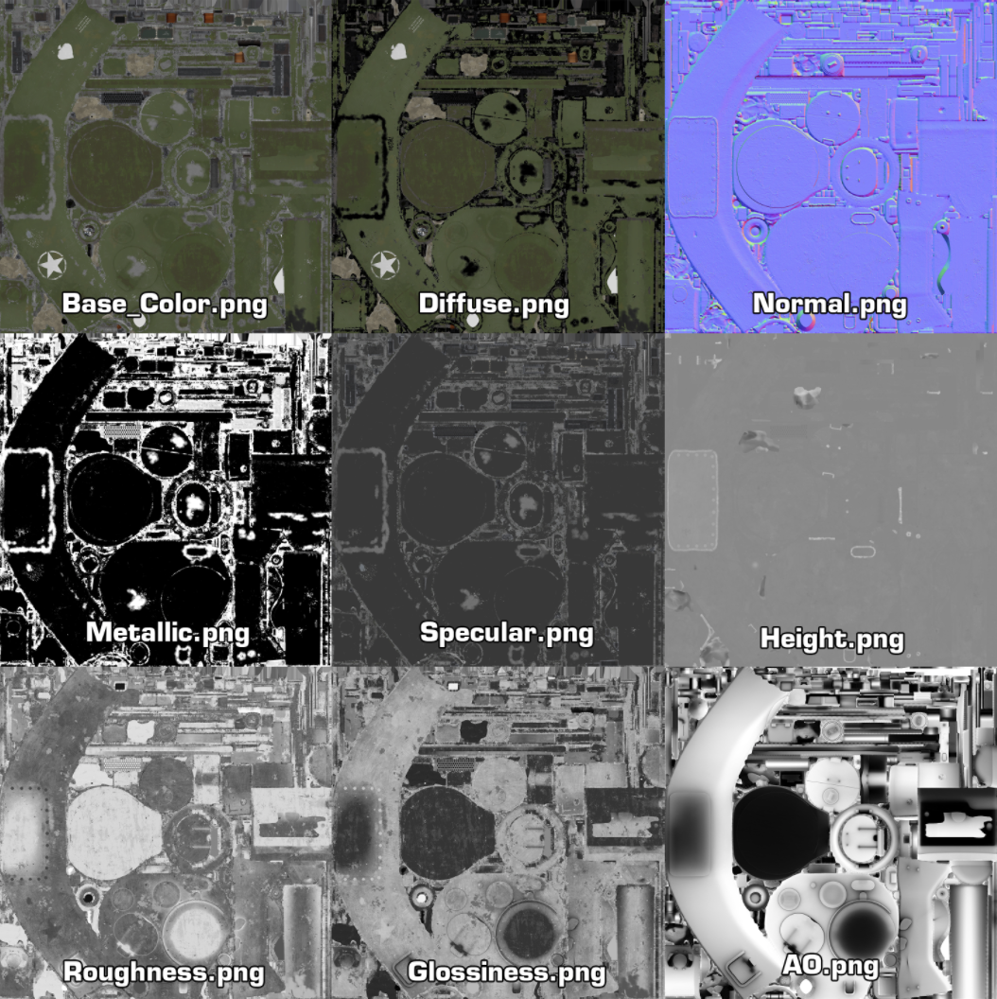
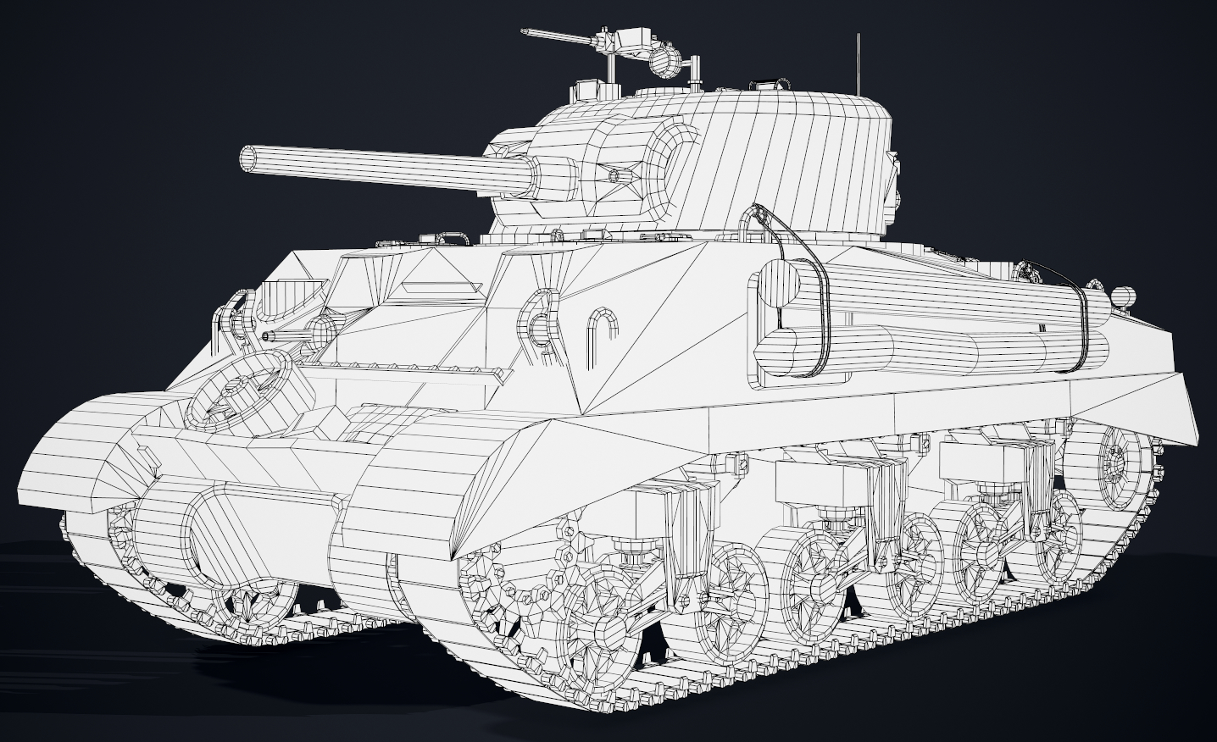
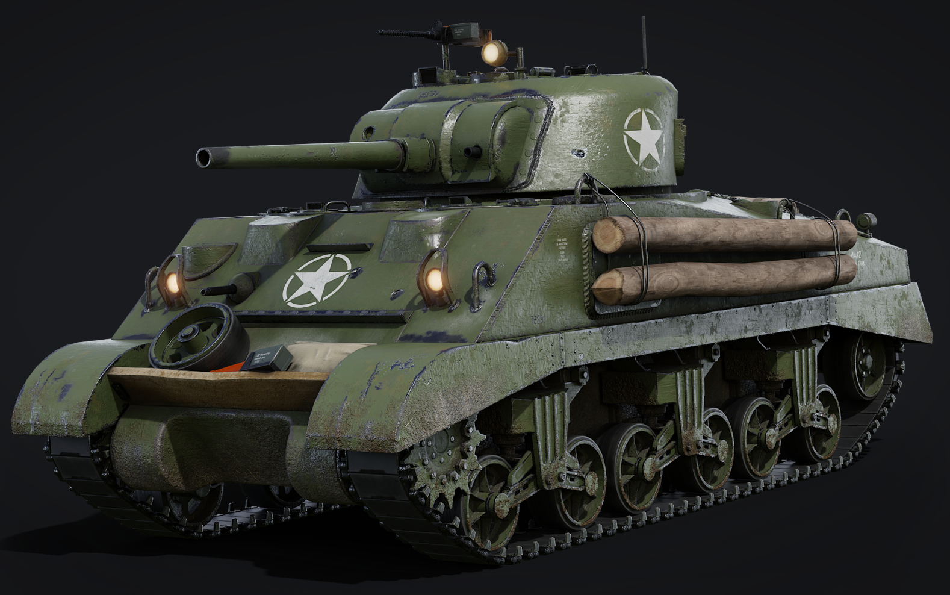
Textures ARE CORE TO 3D RENDERING

Slide 3
BEYOND MODELS: USES FOR HARDWARE TEXTURES
On Screen Render Targets
The Swap-chain/Back-buffer
Off Screen Render Targets
Render To Texture/Post-processing
Z/Depth Buffers
Lights can have them too (Shadow Maps)
Volume/3D Textures
Voxel Data, 3D Scans, Fluid Simulation
Cube Maps (6 sided textures)
Skyboxes & Environments Reflections
Light Maps
Pre-calculated lighting stored in textures
Stencil Buffers
Portals and Mirrors, Stencil Shadows
Height/Displacement Maps
For Terrain and other Tessellated surfaces

Slide 4
TEXTURE FILE FORMATS FOR GPU HARDWARE
Khronos Texture (*.KTX/*.ktx2)
Direct Draw Surface (*.DDS)
Designed for OpenGL and Vulkan
Supports Mipmaps
Supports Cube maps
Supports Hardware Compression
Supports HDR
Designed for Direct3D(All)
Supports Mipmaps
Supports Cube maps
Supports Hardware Compression
Supports HDR

Slide 5
image conversion & enhancement TOOLS
NVidia Texture Tools Exporter (KTX+DDS)
AMD’s Compressonator (KTX+DDS)
PowerVR Texture Tool (KTX+DDS)
AMD Cube Map Generator (legacy)
GIMP Now has native DDS support
Visual Studio can open and save DDS files

Slide 6
What about OTHER COMMON image formats?
When working with Artists specializing in Game Art it may be possible to request textures in .KTX or .DDS, however most 3D art you come across will use a variety of non-HW-specialized image formats like PNG, TGA, JPG etc.…
In this scenario you could load the raw uncompressed image data and generate your own mipmaps, but this approach slows load times and is space inefficient.
A more effective solution is to pre-process this data into KTX and/or DDS formats before using it in the renderer.
Its possible to do this by hand for now, but most studios have build-tools that traverse their raw game assets and convert them to more specialized game-ready formats.

Slide 7

VULKAN DEMO: THE KTX TEXTURE library (LIBKTX)

Slide 8
Q

Slide 9
HARDWARE SamplERS
placeholder

Slide 10
API SPECIFIC TEXTURE LOADING SUPPORT
placeholder

